Slide 1
Data Storage Structures

Slide 2
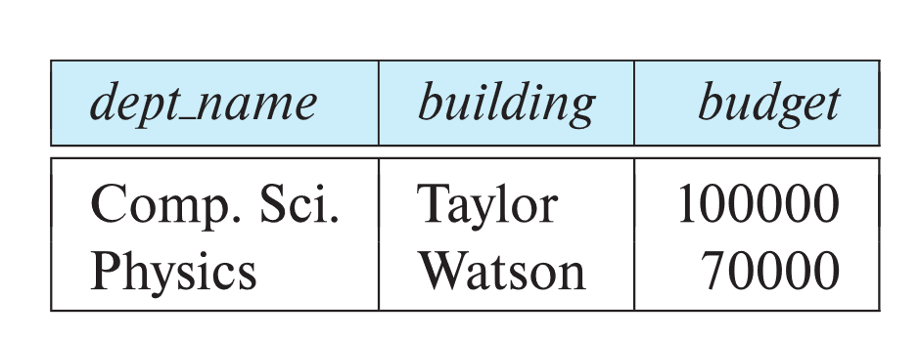
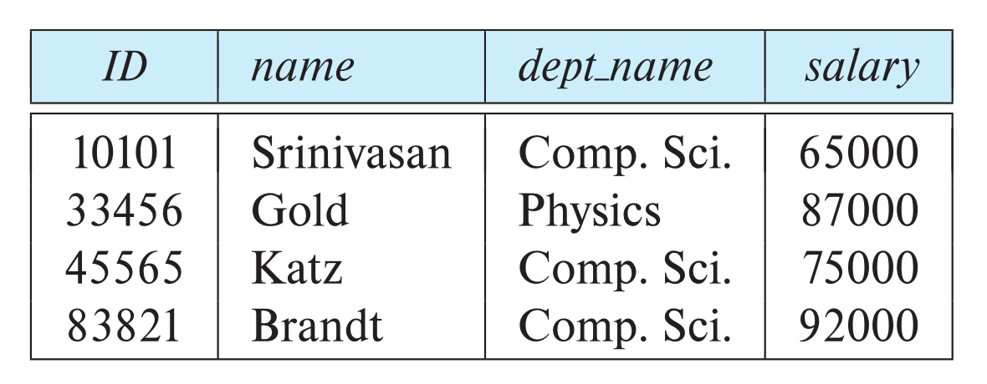
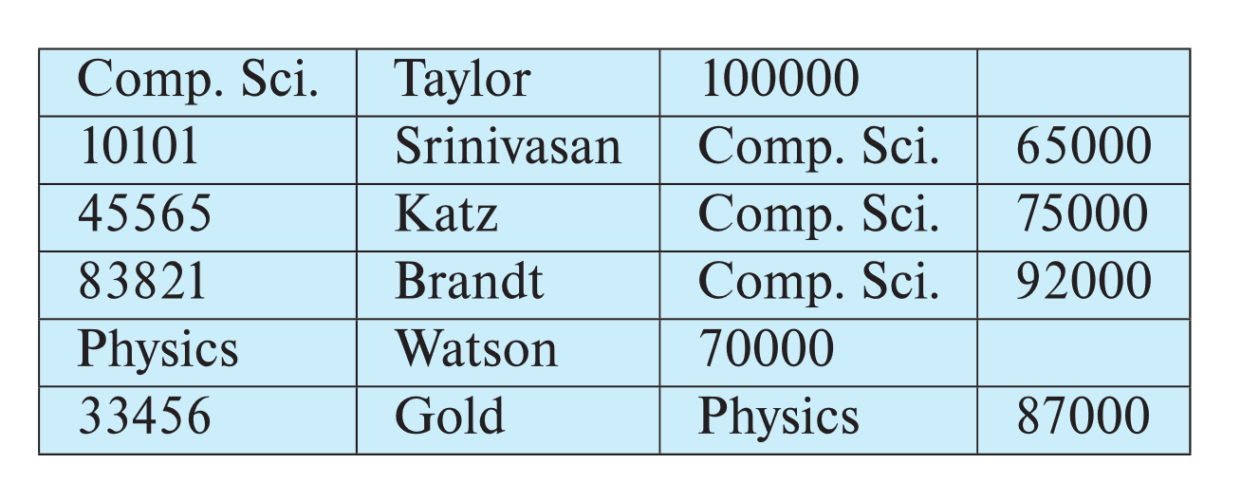
Multitable Clustering File Organization
Store several relations in one file using a multitable clustering file organization
SELECT ID, building
FROM instructor i, department d
WHERE i.dept_name = d.dept_name
department
instructor
Explain how the above query is processed using
Single table file organization
Multi-table file organization
multitable clustering
of department and
instructor

Slide 3
Multitable Clustering File Organization (cont.)
good for queries involving department ⨝ instructor, and for queries involving one single department and its instructors
bad for queries involving only department
results in variable size records
Can add pointer chains to link records of a particular relation

Slide 4
Data Dictionary Storage
The Data dictionary (also called system catalog) stores metadata; that is, data about data, such as
Information about relations
names of relations
names, types and lengths of attributes of each relation
names and definitions of views
integrity constraints
Question 7-1: In DBMS, you cannot create two tables or two views with the same name for the same user.
How is it implemented?

Slide 5
Data Dictionary Storage
The Data dictionary (also called system catalog) stores metadata; that is, data about data, such as
User and accounting information, including passwords
Statistical and descriptive data
number of tuples in each relation
Physical file organization information
How relation is stored (sequential/hash/…)
Physical location of relation

Slide 6
Relational Representation of System Metadata
Relational representation on disk
Specialized data structures designed for efficient access, in memory
Question 7-2: In DBMS, you cannot create two attributes or two indices with the same name for the same table.
How is it implemented?

Slide 7
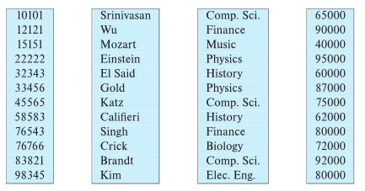
Column-Oriented Storage
Also known as columnar representation
Store each attribute of a relation separately
Example

Slide 8
Columnar Representation
Benefits:
Reduced IO if only some attributes are accessed (How?)
SELECT id, salary FROM instructor
Improved CPU cache performance (How?)
Improved compression (How?)
Vector processing on modern CPU architectures (Parallel CPU operation on multiple elements of an array.

Slide 9
Columnar Representation
Drawbacks
Cost of tuple reconstruction from columnar representation (What?)
Select * from instructor where id = 32343
How will this query be executed using columnar storage?
Search id column and find 32343 and the tuple-id (here it is 5)
Query result = 32343, 5th value of name column, 5th value of dept-name column, 5th value of salary column

Slide 10
Columnar Representation
Drawbacks
Cost of tuple deletion and update (What?)
Delete from instructor where dept-name = ‘History’
Find tuple-id of ‘History’ from dept-name column ( tuple-id = 5, 8)
Delete tuple-id = 5, 8 from all 4 columns
Similar is update

Slide 11
Columnar Representation
Drawbacks
Cost of decompression (What?)
Columns are stored in compressed format. Every query requires decompression
Columnar representation found to be more efficient for decision support than row-oriented representation (Why?)
Data Warehouse (DW) is used for decision support
DW uses only few attributes, no update and only data insert.
So column storage is efficient

Slide 12
Columnar Representation
Drawbacks
Traditional row-oriented representation preferable for transaction processing (Why?)
Transaction processing requires frequent update and deletion
Some databases support both representations
Called hybrid row/column stores

Slide 13
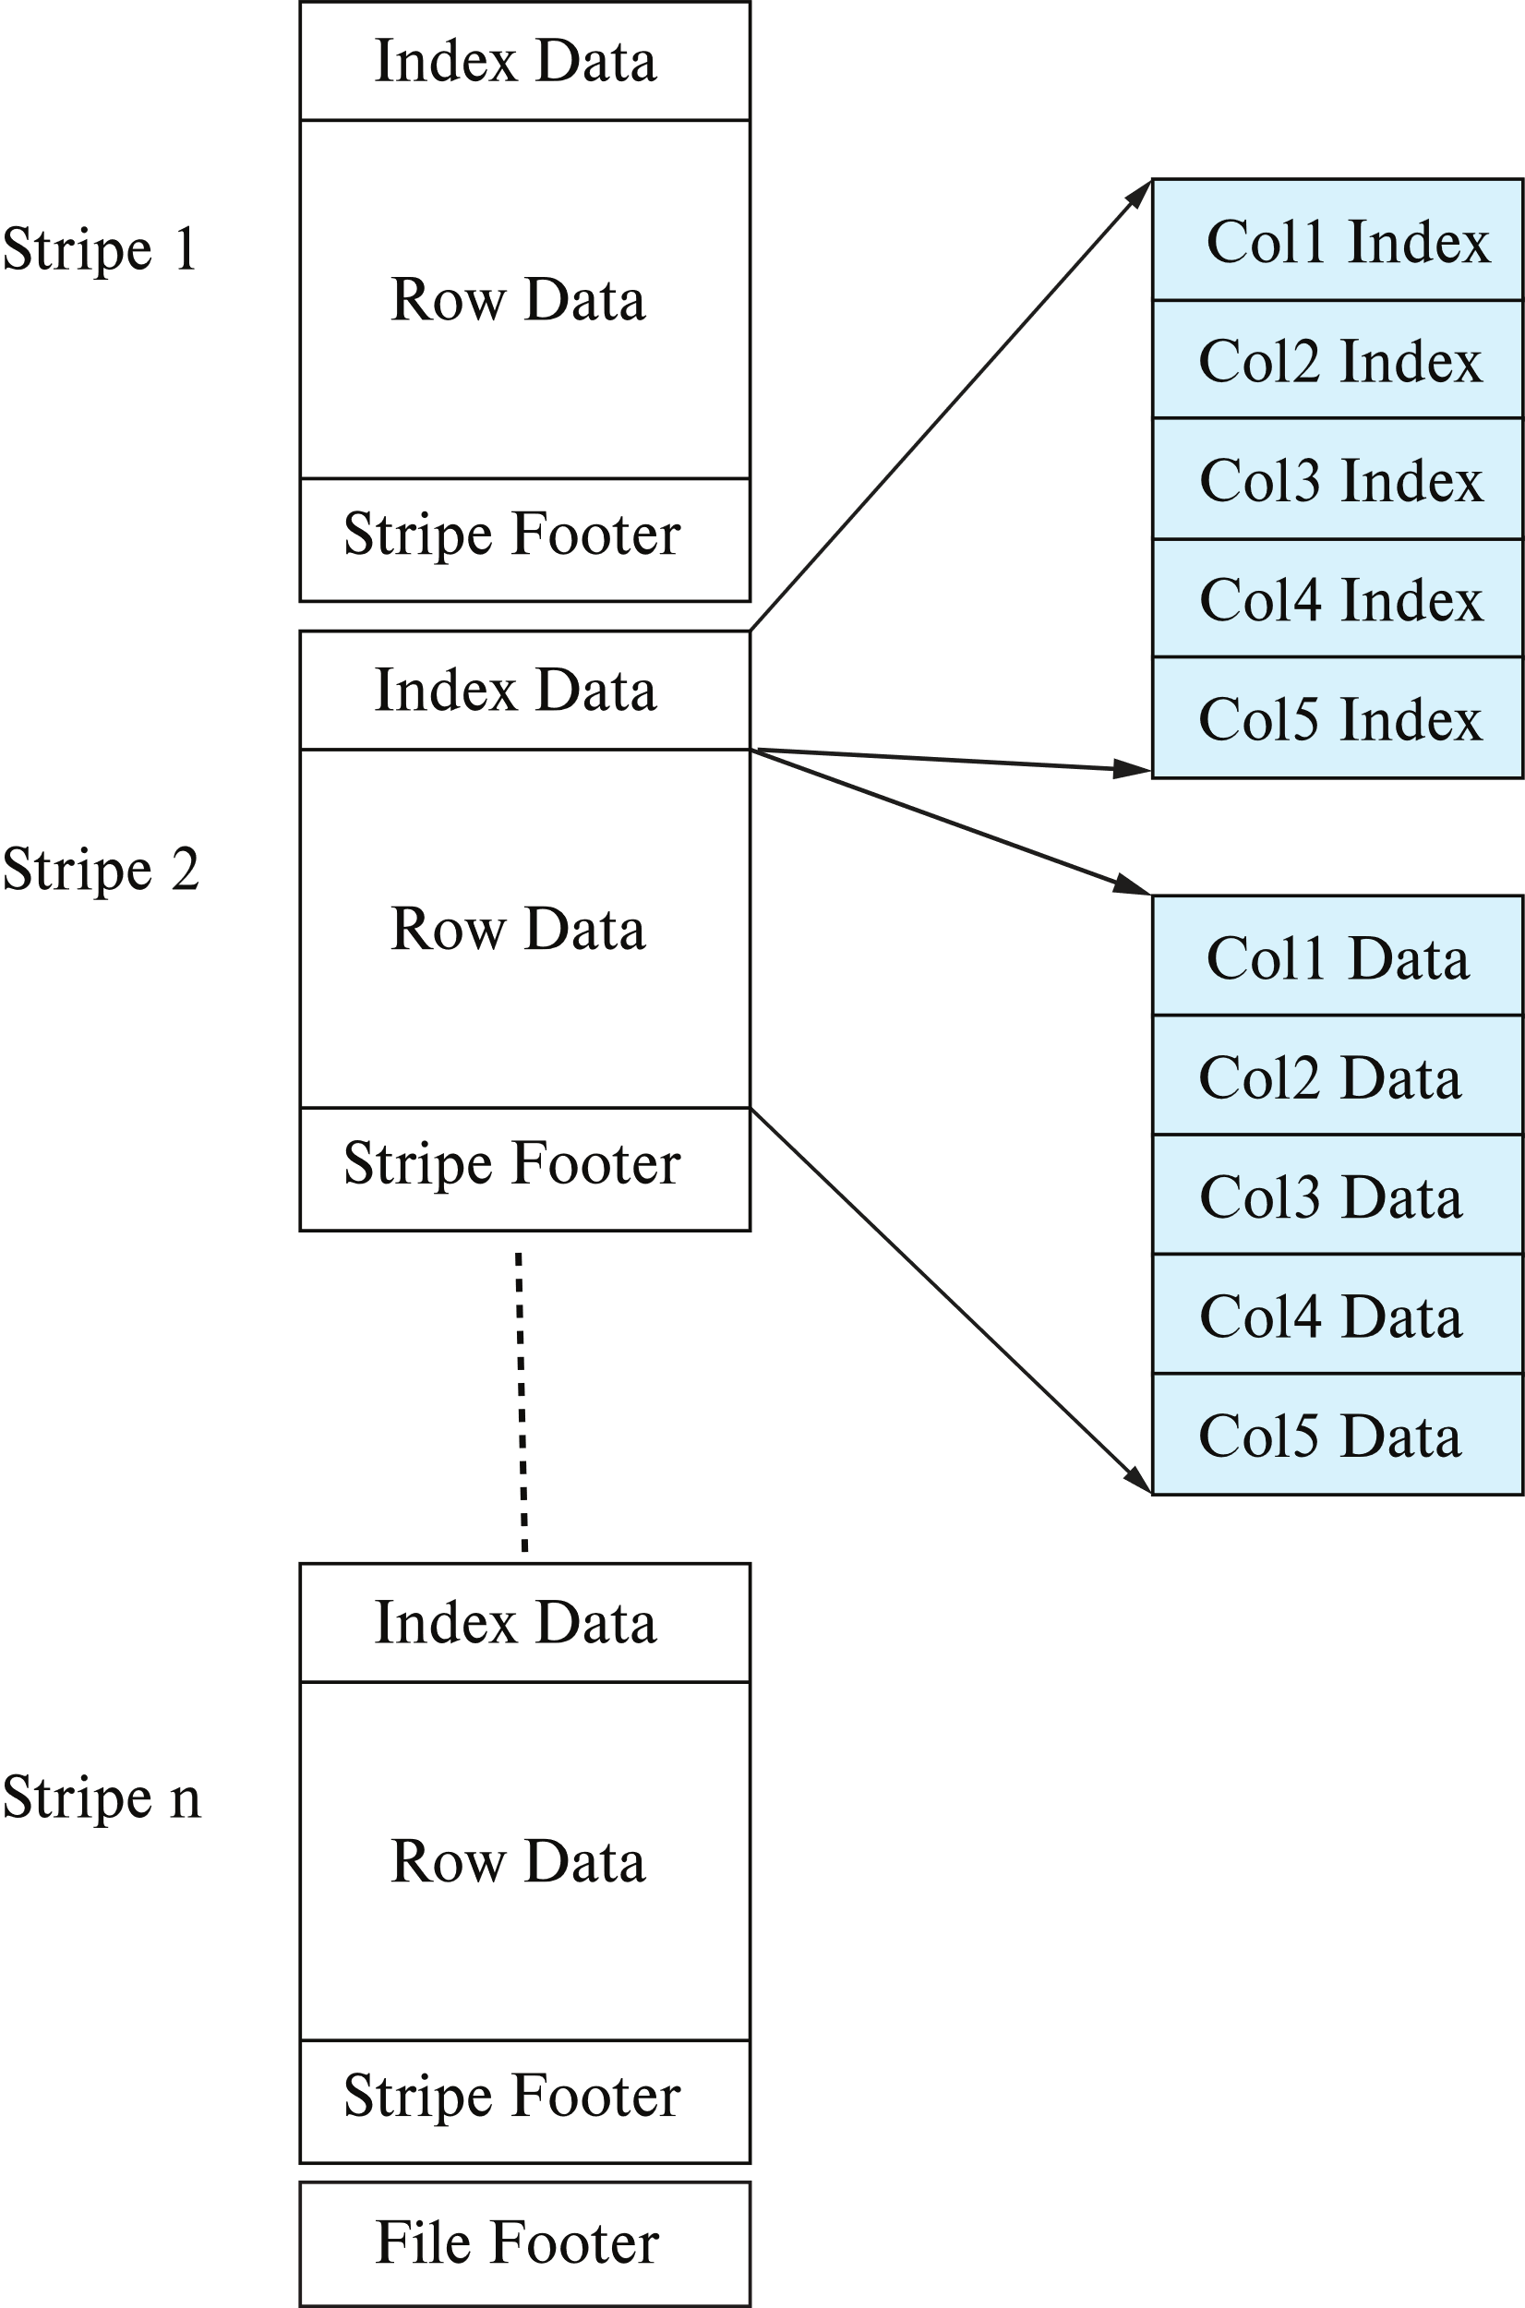
Columnar File Representation
ORC (Optimized Row Columnar) and Parquet: file formats with columnar storage inside file
Very popular for big-data applications
Orc file format shown on right:

Slide 14
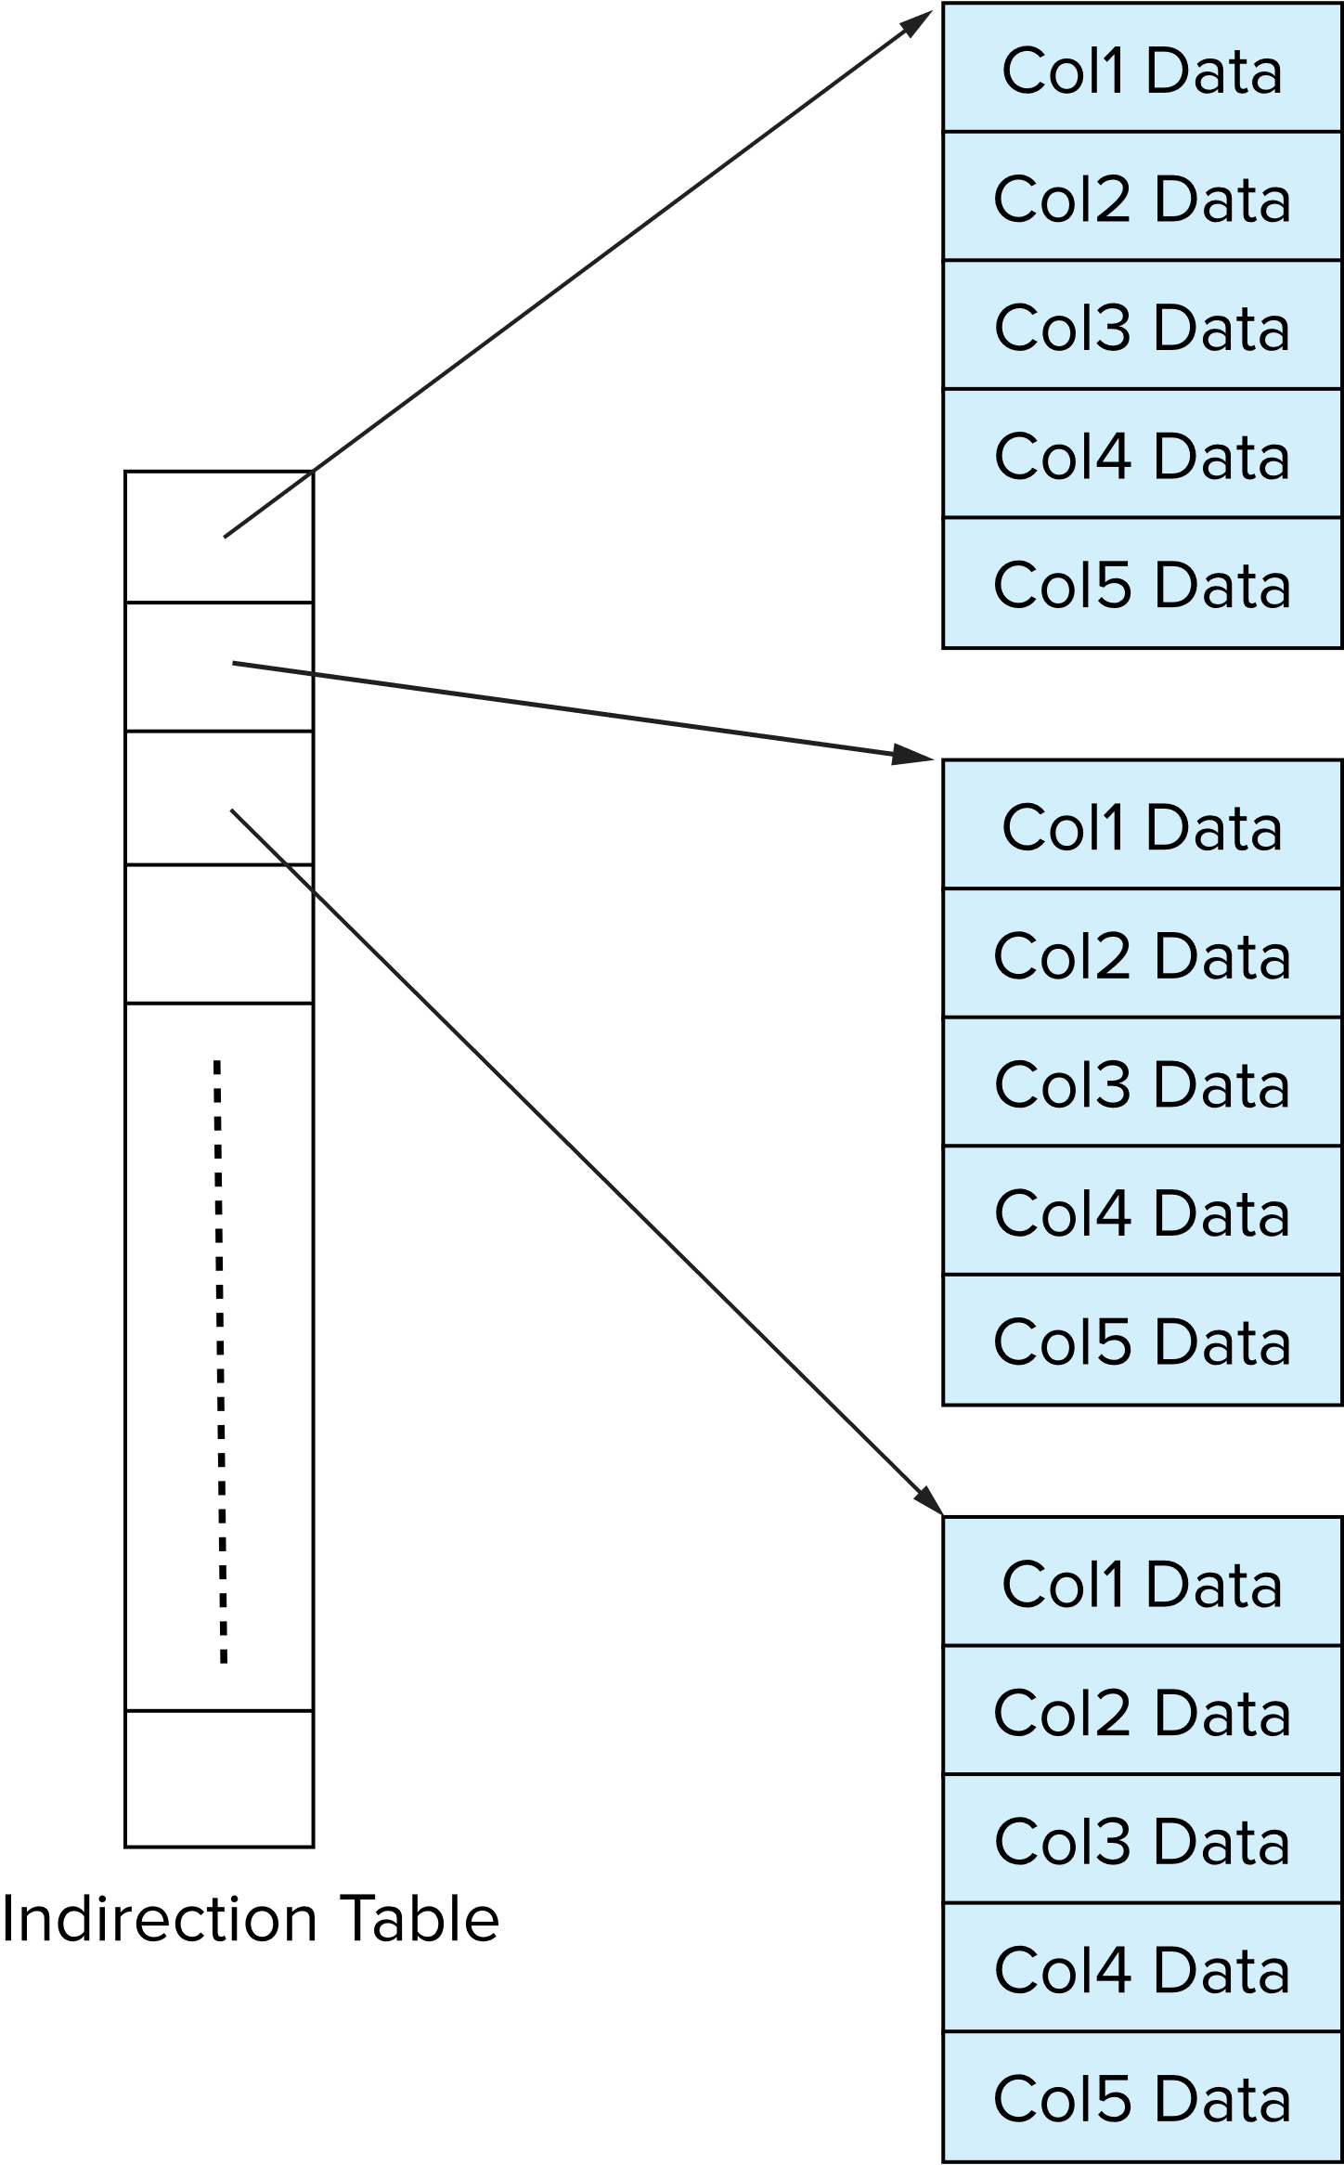
Storage Organization in Main-Memory Databases
Can store records directly in memory without a buffer manager
Column-oriented storage can be used in-memory for decision support applications
Compression reduces memory requirement
V1
V2
V3
The values of V1, V2, V3, V4 are 1000, 2000, 3000, 4000 respectively.
Find 2500th tuple?

